Slide 1
DNA/Polymerase Binding Kit P6 v2
January 15, 2015

Slide 2
DNA/Polymerase Binding Kit P6 v2
Observed lower productive fraction with P6 compared to P5, requiring higher concentration to achieve similar productivity as P5
Goal: Optimize the binding reaction and conditions
Solution:
Increased nucleotide concentration for polymerase binding → higher productivity
Increased binding kinetics
Binding is complete in 30 minutes
Optimize other reaction conditions

Slide 3
Increased Yield with DNA/Polymerase Binding Kit P6 v2 Across Different Sample Types
P6 – dNTP v1
P6 – dNTP v2
nReads (x10³)
2 kb Lambda 10 kb, E.coli 20 kb E.coli 20 kb E.coli
Diffusion no-SS 7 kb cutoff 15 kb cutoff
Notes:
The loading concentrations used in this experiment were not optimal. These numbers were chosen only for this experimental design comparing the two versions of P6 binding kits.
Experimental loading concentrations:
150 pM for diffusion loading
50 pM for MagBead loading

Slide 4
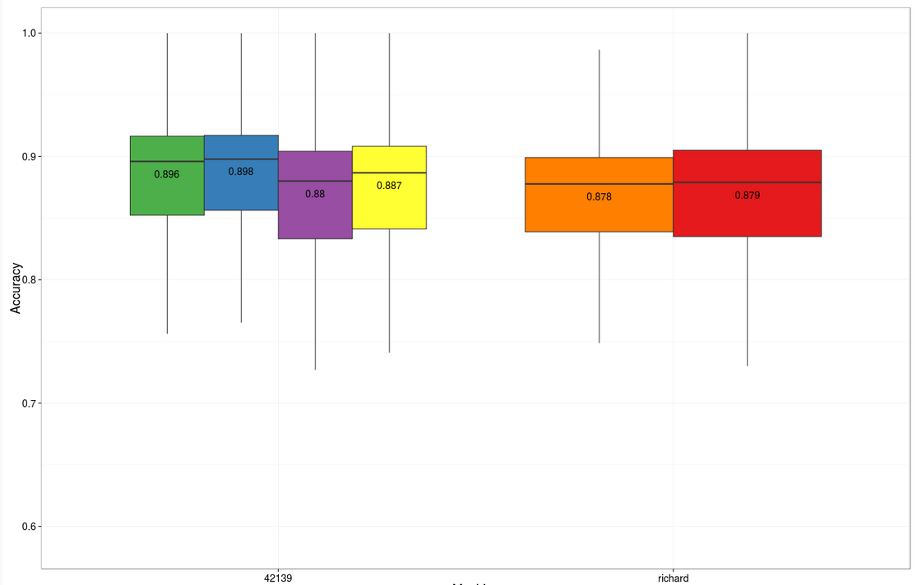
No Effects on Mapped Accuracy with DNA/Polymerase Binding Kit P6 v2
v2
v1
v2
v1
v2
v1
10 kb
Non-size
selected
20 kb,
7 kb Cutoff
20 kb,
15 kb Cutoff
Notes:
There is no effect in accuracy.

Slide 5
Summary of Changes
Updated Binding Kit: DNA/Polymerase Binding Kit P6 v2
Single tube change: Increased nucleotide concentration
All other components remain the same
New binding kit P/N 100-372-700
Updated Workflow:
Simple changes
New primer annealing reaction conditions
New polymerase binding reaction conditions
Binding Calculator updates
Notes:
Changes to the workflow are very simple and easy to implement.

Slide 6
Summary of Changes
No changes to instrument control software
New Barcode
Barcode is already available in ICS v2.3
Instrument recognizes the new barcode
Primary analysis training is the same
Notes:
No instrument control changes. New part numbers included and tested with original version 2.3. Will utilize same primary and secondary training as P6V1

Slide 7
New Recommendations for Primer Annealing
Dilute primer (5000 nM→ 150 nM)
Add primer to SMRTbell™ template in 1x Primer Buffer
Incubate at 80°C for 2 minutes followed by ramp down to 25°C at 0.1°C per second
Dilute primer (5000 nM →150 nM*)
Heat diluted primer at 80°C for 2 minutes followed by rapid cool down to 4°C
Add conditioned primer to SMRTbell template in 1x Primer Buffer
Incubate at 20°C for 30 minutes
Minimize exposure of SMRTbell templates to elevated temperature (80°C)
*150 nM is stable for 30 days
Notes:
Heat treatment is necessary only for the primer and not for the template. Which is why the 80°C treatment is separate step. This also minimizes exposure of the SMRTbell templates to high temperature that can result to DNA nicks.

Slide 8
New Recommendations for Polymerase Binding
Diffusion loading:
Incubate at 30 °C for 4 hrs
MagBead loading:
Incubate at 30 °C for 4 hrs followed by 30 mins 37 °C heat kill
Diffusion loading:
Incubate at 30 °C for 30 mins, no heat kill
MagBead loading:
Incubate at 30 °C for 30 mins, no heat kill
Reduced incubation time
Heat kill is not necessary for Diffusion and MagBead loading
Notes:
Binding kinetics is more efficient with dNTPv2 which is why binding is complete in 30 mins.

Slide 9
Binding Calculator v2.3.1
Download the latest version of Binding Calculator through GitHub
Available January 16, 2015
https://github.com/PacificBiosciences/BindingCalculator
Google: key words “binding calculator pacbio”
Summary of Changes:
Loading recommendations are updated
DNA Control updates
Radial button for size selection or no size selection
“Conditioning Primer” section describes the new primer annealing step
Implementation of the new polymerase binding step
Updated texts and error messages for clarity

Slide 10
Updated Documents
QRC - Annealing and Binding Recommendations
Guide - Pacific Biosciences® Sample Preparation and Sequencing
User Bulletin - Guidelines for Preparing 20 kb SMRTbell™ Templates
Procedure & Checklist - Greater Than 10 kb Template Preparation Using AMPure PB Beads
Procedure & Checklist - 20 kb Template Preparation Using BluePippin™ Size-Selection

